Slide 1

Data Base Management System Cornerstone Project
Final Review – I &II
HOSPITAL MANAGEMENT SYSTEM
A Project Guided By V G L Narasamba Mam
Presented By
Y B Sri Lekha – 25B11AIC90
I Mounika Sri – 25B11AI407
P Sahasra – 25B11AI882
P Navya Sri – 25B11AI932
Department of
ARTIFICIAL INTELLIGENCE &MACHINE LEARNING

Slide 2




Presentation Outline
Abstract
Finalize title, objectives & problem statement
Identify entities & attributes
Design ER diagram & relationships
Prepare relational database schema
Define Primary & Foreign Keys
Create GitHub repo & responsibilities
Database creation & constraints
Insert sample data
DDL, DML & DQL operations
CRUD operations & SQL queries
Data integrity & validation
Project documentation
Demonstrate & present database
Conclusion

Slide 3

ABSTRACT
The Hospital Management System is a DBMS project designed to manage hospital records digitally. It manages patients, doctors, appointments, treatments, admissions, billing, and medicines in a centralized database. The system reduces data errors and makes information retrieval easier using ER diagrams, tables, Primary Keys, and Foreign Keys.

Slide 4
DESIGN
Objectives
Maintain patient and doctor records
Manage appointments, treatments and admissions
Manage medicines, prescriptions and billing
Retrieve information using SQL
Establish relationships using PK and FK
Problem Statement
Manual hospital records can cause data duplication, inconsistency, retrieval difficulties, appointment tracking issues, and billing errors. A centralized database is needed for efficient hospital data management.

Slide 5
ENTITIES & ATTRIBUTES
DESIGN
Entities & Attributes
Patient – Patient_ID, Name, Gender, DOB, Phone
Doctor – Doctor_ID, Name, Specialization, Phone, Email
Department – Department_ID, Name, Location
Appointment – Appointment_ID, Patient_ID, Doctor_ID, Date, Time
Admission – Admission_ID, Patient_ID, Room_ID, Dates
Treatment – Treatment_ID, Patient_ID, Doctor_ID, Diagnosis
Billing – Bill_ID, Patient_ID, Amount, Payment_Status
Medicine – Medicine_ID, Name, Category, Price, Stock

Slide 6
RELATIONAL DATABASE SCHEMA
DESIGN
Based on your Hospital Management System, use the following schema:
PATIENT
PATIENT(Patient_ID PK, First_Name, Last_Name, Gender, Date_of_Birth, Phone, Address)
DEPARTMENT
DEPARTMENT(Department_ID PK, Department_Name, Location, Contact_No)
DOCTOR
DOCTOR(Doctor_ID PK, Doctor_Name, Specialization, Phone, Email, Department_ID FK)
APPOINTMENT
APPOINTMENT(Appointment_ID PK, Patient_ID FK, Doctor_ID FK, Appointment_Date, Appointment_Time, Status)
ADMISSION
ADMISSION(Admission_ID PK, Patient_ID FK, Room_ID FK, Admission_Date, Discharge_Date)
TREATMENT
TREATMENT(Treatment_ID PK, Patient_ID FK, Doctor_ID FK, Diagnosis)
BILLING
BILLING(Bill_ID PK, Patient_ID FK, Amount, Payment_Status)
MEDICINE
MEDICINE(Medicine_ID PK, Name, Category, Price, Stock)
ROOM
ROOM(Room_ID PK, Room_Number, Room_Type, Availability_Status)

Slide 7
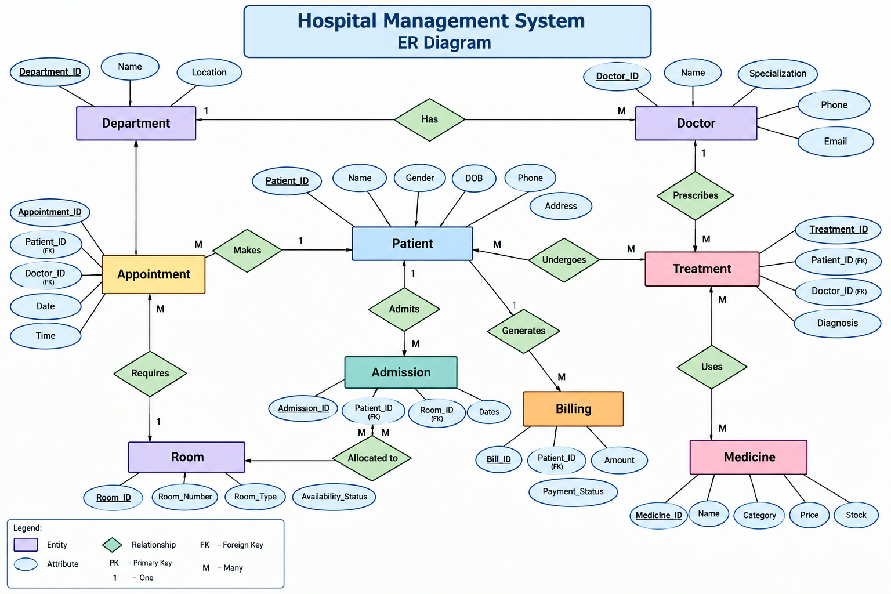
ER DIAGRAM
DESIGN

Slide 8
PRIMARY & FOREIGN KEYS
DESIGN
🔑 Primary Key & Foreign Key
Primary Key (PK)
Uniquely identifies each record.
Example: Patient_ID
Foreign Key (FK)
Connects two tables.
Refers to the Primary Key of another table.
Example: Department_ID in Doctor table.
Example Relationship:
Doctor.Department_ID → Department.Department_ID

Slide 9
GITHUB REPOSITORY & TEAM
DESIGN
GitHub Repository Contains :
SQL source file
Database queries
ER diagram
Project documentation
Screenshots / project resources
Team Responsibilities :
Database design
SQL implementation
ER diagram and schema
Documentation and presentation
Repository :
https://github.com/ybsrilekha-1408/Hospital-Management-System

Slide 10
DATABASE & CONSTRAINTS
IMPLEMENTATION
DATABASE & CONSTRAINTS
Created the database tables in Oracle Database
Used Oracle SQL*Plus / Run SQL Command Line
Defined Primary Keys and Foreign Keys
Used NOT NULL constraints
Maintained data integrity
Established relationships between related tables

Slide 11
SAMPLE DATA INSERTION
IMPLEMENTATION
SAMPLE DATA INSERTION :
Sample records were inserted into the hospital tables.
Sample data includes:
Patient records
Doctor records
Department records
Appointment records
Admission records
Treatment records
Billing records
Medicine records
Total project tables: 8

Slide 12
DDL, DML & DQL OPERATIONS
IMPLEMENTATION
SQL OPERATIONS :
DDL – Data Definition Language
CREATE
ALTER
DML – Data Manipulation Language
INSERT
UPDATE
DELETE
DQL – Data Query Language
SELECT

Slide 13
CRUD & SQL QUERIES
IMPLEMENTATION
CRUD OPERATIONS :
C – Create → INSERT
R – Read → SELECT
U – Update → UPDATE
D – Delete → DELETE
Other SQL Operations :
JOIN queries
Filtering using WHERE
Sorting using ORDER BY
Data retrieval from related tables

Slide 14
DATA INTEGRITY & VALIDATION
IMPLEMENTATION
DATA INTEGRITY & VALIDATION :
Primary Keys prevent duplicate record identification.
Foreign Keys maintain relationships between tables.
NOT NULL constraints ensure required fields contain values.
Valid data is inserted according to the table structure.
SQL queries are used to verify stored records.
Data consistency is maintained across related tables.

Slide 15
PROJECT DOCUMENTATION
IMPLEMENTATION
PROJECT DOCUMENTATION :
The project documentation includes:
Project Introduction
Objectives
Problem Statement
Entities and Attributes
ER Diagram
Relational Schema
Primary & Foreign Keys
SQL Queries
Database Outputs
Screenshots
Conclusion

Slide 16
DEMONSTRATE & PRESENT
IMPLEMENTATION
DATABASE DEMONSTRATION :
During the live demonstration:
Open Oracle SQL*Plus
Show the database tables
Display Patient records
Execute a SELECT query
Demonstrate a JOIN query
Demonstrate UPDATE operation
Demonstrate DELETE operation
Explain the outputs

Slide 17
CONCLUSION
Successfully designed a Hospital Management System database.
Implemented 8 relational tables.
Established relationships using Primary and Foreign Keys.
Stored patient, doctor, appointment, admission, treatment, billing and medicine information.
Performed DDL, DML and DQL operations.
Future Scope :
Develop a graphical user interface
Add user authentication
Generate automated reports
Add advanced analytics

Slide 18
THANK YOU

